Slide 1
Utilisation of the data center excess heat
EU-funded JTF-project
Silja Keränen (KAMK), Kyösti Ruuttunen (LUKE)
22.5.2025

Slide 2
Why should a data center utilize excess heat?
Profitability: Electricity tariff class
Electricity tax category I: 2.253 cents / kWh -> 22.5 e / MWh
Electricity tax category II: 0.063 cents / kWh -> 0.63 e / MWh
Obligation: EU Energy Efficiency Directive
Member States must ensure that data centers with a nominal total energy input of more than 1 MW utilize excess heat or apply other excess heat recovery solutions, unless they can demonstrate that it is not technically or economically feasible.
Incentive: Clean transition investment permit
New Construction Act (751/2023) includes an opportunity for a clean transition investment permit
This includes also data centers

Slide 3
Excess heat amounts
Estimating the potential amounts of the excess heat in Kajaani, Renforsin Ranta area.
Estimate indicates that by 2027, the amount of raw excess heat from data centers will be approximately 500 GWh
Total amount of excess heat power will be almost 2 TWh in year 2030
For comparison (not scalable one to one): Heat demand for Kajaani district heating is 300 GWh per year.
3
Notes:
CSC:n LUMI-konesali
Vuonna 2023 LUMI tuotti 26,7 GWh hukkalämpöä (Noin 3 MW keskiteho)
Rakennettu sähköteho noin 10 MW
Hetkellinen hukkalämmön maksimiteho kaukolämmöksi 7 MW
Renforsin Rannan datakeskukset (arvio 11/2024)
Vuonna 2027 kokonaisteho 90 MW, mistä raakalämpöä 60 MW (530 GWh)
Vuonna 2030 kokonaisteho 300 MW, mistä raakalämpöä 220 MW (1900 GWh)
Raakalämpö voidaan priimata lämpöpumpulla, jolloin voidaan saada jopa 3 kertainen teho vähennettynä pumpun käyttämällä sähkön määrällä
Otanmäen datakeskus (arviot tarkentuvat loppuvuodesta 2024)
Vuonna 2027 teho 60 MW, mistä raakalämpöä 45 MW (390 GWh)
Vuonna 2030 teho 250 MW, mistä raakalämpöä 190 MW (1600 GWh)

Slide 4
Utilisation of the Data Center Excess Heat -project
Objectives
Getting data center investments in Kajaani
Development of new business operations around excess heat from data centers
Promoting a circular low-carbon economy
Demography
Funding: JTF (EU's Just Transition Fund for phasing out peat)
Duration: 1.1.2024 – 31.12.2025
Budget: 385 500€
Implementers: Kajaani University of Applied Science (KAMK) CSC – IT Center for Science Natural Resources Institute Finland (LUKE)
Financing: JTF 80%, other: KAMK, CSC, LUKE, City of Kajaani, Redeve and Loiste Heat

Slide 5
Excess heat utilisation possibilities
District heating
Biomass drying (timber, sawdust, biogas digestion residue, etc.)
Food production: greenhouse, mushrooms, algae, fish
Heat to electricity
Cooling
Wastewater treatment optimization
Other possibilities: various chemical industry processes, hydrogen production integration, snow melting…
5
Notes:
Kajaanin keskustaajaman kaukolämpö noin 300 GWh vuodessa
100 ha puutarha 600 GWh. Suomessa nykyään noin 200 ha puutarhatuotantoa.

Slide 6
Latest updates
Literature review published. Available in Finnish already, translation into English to be published soon.
This seminar ☺
Articles published soon in Biokierto & Biokaasu magazine, Puutarha & Kauppa magazine, and the City of Kajaani's newsletter
Webinar series planned for next autumn
A project related to DC and excess heat research has been applied for
6

Slide 7
DC excess heat possibilities in bioeconomy
Heating and drying processes

Slide 8
Excess heat potential in bioeconomy
Identified application areas
Sawmill products and sidestreams drying
Biogas reactor heating and recycled fertilizer production
Wastewater treatment enhancement
Greenhouses and mushroom cultivation
Aquaculture: fish and crustacean (e.g. shrimp)
Insect farming

Slide 9
Drying of lumber and sawmill by-products
Sawn timber production in Finland more than 11 million m³ → export value almost 2.6 billion EUR
In Kainuu: approx. 430,000 m³ → 130 million EUR
In addition to sawn timber, significant amount of sidestreams produced
Product yield is <50%
Sidestreams: sawdust (14%), bark (9%), and sawmill chips (32%)
The timber products need to be thermally dried
Original moisture 50-60% → max. 20%
Needed hot air temperature 50-130 °C (depend on the technique)
Currently, sidestreams combusted for heat production
Excess heat: potential to commercialize sidestreams & decrease CO₂ emissions

Slide 10
Biogas production and digestate drying
Biomethane (CH₄) is produced in anaerobic bioreactors
Raw materials: agricultural and industrial biodegradable sidestreams (livestock manure, food waste, wastewater, sewage sludge etc.)
Biomethane used as (transport) fuel, replacing natural gas
Production in Finland 1 TWh (2019), probably increased in the future
Bioreactor temperature normally 30-42 °C
Higher temperatures (up to 55 °C) enhance methane production but make the process challenging to control
→ Heating required!
Residual sludge a.k.a. digestate: dry matter content 5-7 w.%, contains valuable nutrients
Excess heat: potential to enhance methane production and drying of digestate to recycled fertilizer production

Slide 11
Wastewater treatment
Wastewater treatment largely based on microbiological processes
Efficiency depends on temperature
Legislation becoming more stringent
Nitrogen-containing effluents may cause eutrophication of lakes & rivers
→ Nutrient removal from wastewater needs to be more efficient
In Finland, wastewater treatment temperatures naturally low (6-14 °C)
Optimum temperature for nitrogen removal 20-32 °C
Excess heat: potential to enhance wastewater treatment, e.g. removal of nitrogen

Slide 12
Greenhouses and mushroom cultivation
In Finland, total area of greenhouses 350 ha (2023)
Most important production greenhouse vegetables, also ornamental plants
Most important area Ostrobothnia – only 1.7 ha in Kainuu
Currently self-sufficiency in Finland: cucumber 94%, tomatoes 59%
Greenhouses require heating → enhances growth
Energy used for heating: 619 GWh electricity, 311 GWh heat (most important fuel: forest chips)
Very few greenhouses use excess energy from industrial processes
Some experiments made with data centre excess heat (e.g. Sweden, Japan)
Also mushroom cultivation can be enhanced with heat (optimum 20-30 °C)
Excess heat: can increase sustainability and self-sufficiency in the greenhouse vegetables and mushroom production

Slide 13
Aquaculture: fish and shrimps
Finnish production of farmed fish: 15.2 million kg (2023)
Rainbow trout (95%), also arctic char, whitefish, trout, sturgeon
Most production in the marine areas, inland fish farming 3.2 million kg (especially in Kainuu & Lapland)
Aim: increasing the production
Heating the incoming water in recirculating aquaculture system (RAS)
water circulated continuously between fish tanks and water treatment units → optimizing water consumption, minimizing effluents
Optimum for rainbow trout 15-17 °C, pikeperch 16–20 °C, whiteleg shrimp 26–32 °C
Excess heat: possible to make fish and crustacean farming more efficient, introduction of new species

Slide 14
Insect farming
Insects can be grown
for food: house cricket (Acheta domesticus)
for feed: mealworm (Tenebrio molitor)
for waste management: black soldier fly (Hermetia illucens)
Insect farming is a developing business: two recently founded Finnish companies developing industrial-scale black soldier fly facilities
Converting food waste to protein, fat, and nutrient-rich residue (frass)
→ Producing feed, fat, biofuel, fertilizers
Optimal temperature for rearing mealworms and black soldier fly 25–30 °C
Excess heat: making production of insect-based food and feed more sustainable

Slide 15
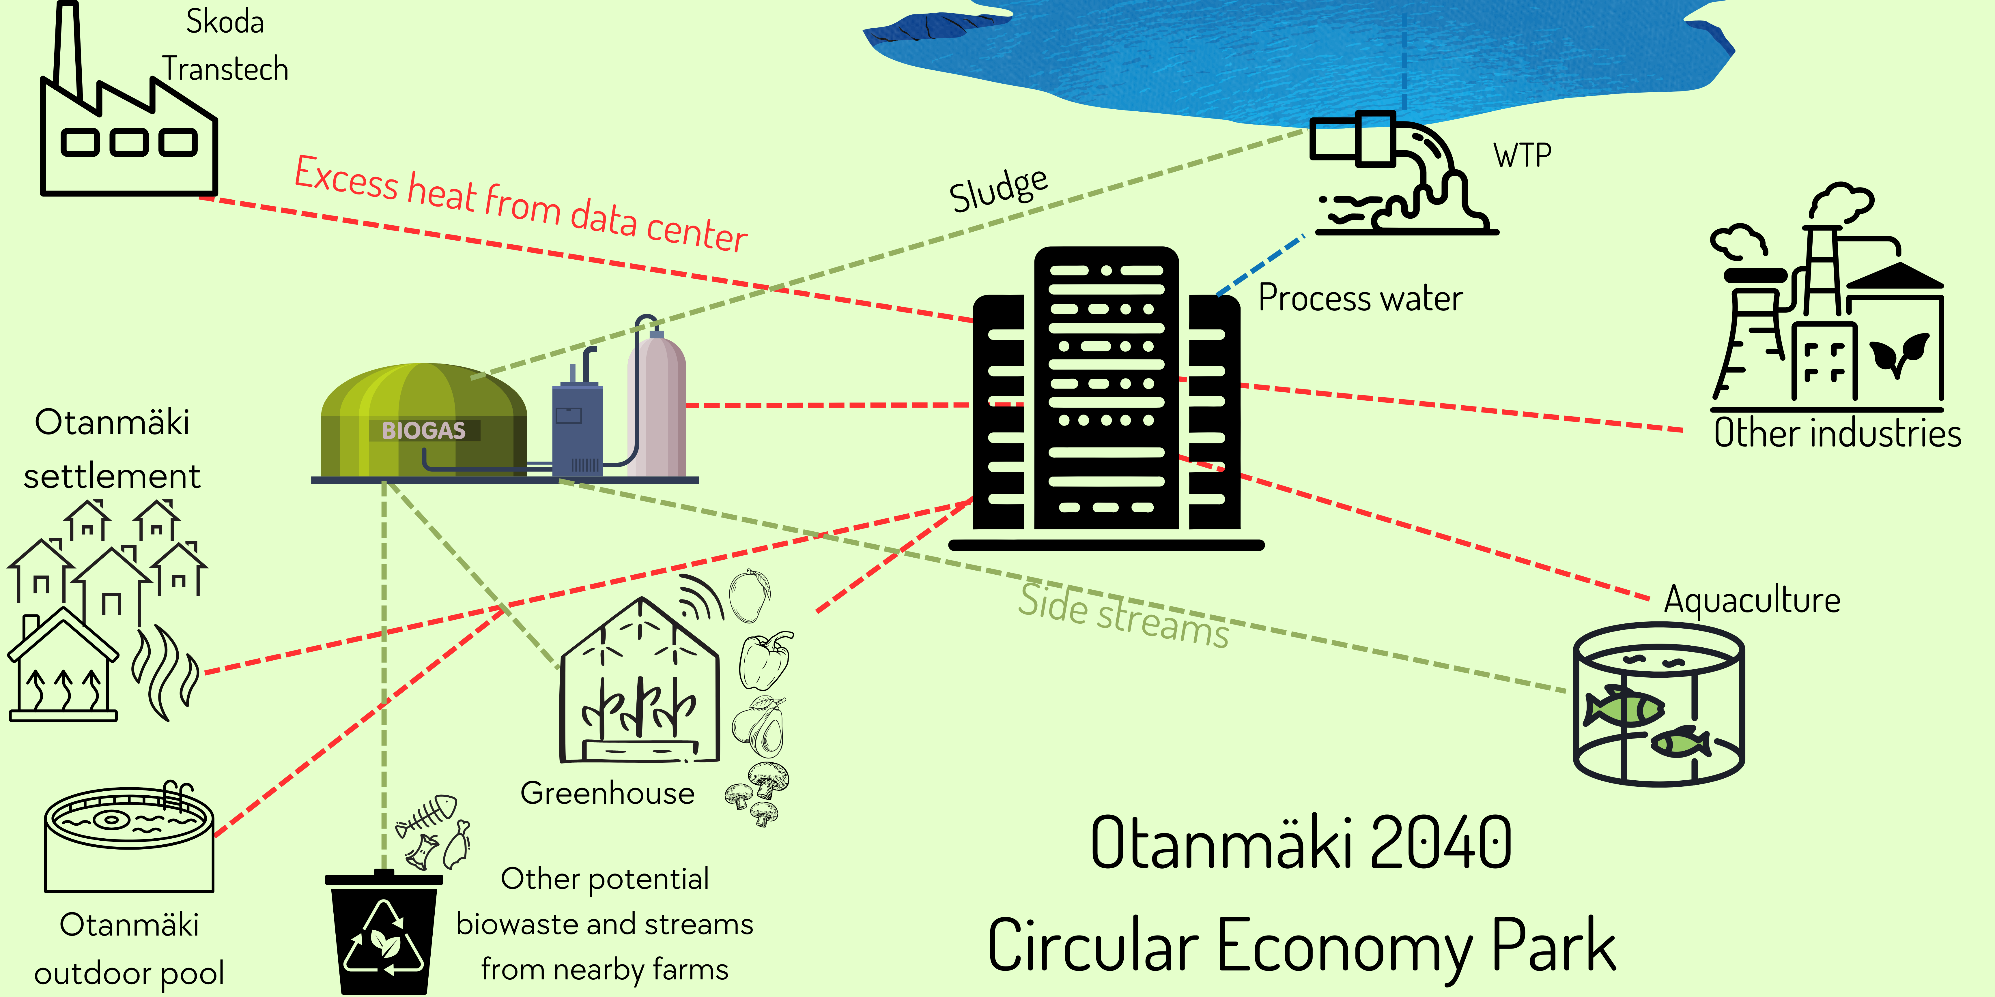
Industrial ecosystem based on DC excess heat

Slide 16
Contact information
KAMK
Silja Keränen, Project manager: silja.keranen@kamk.fi / 044 710 0288
Jenni Kinnunen: jenni.kinnunen@kamk.fi
Janne Pietarila: janne.pietarila@kamk.fi
Janne Tolonen: janne.Tolonen@kamk.fi
16

Slide 17
Contact information
CSC
Mikko Kerttula, Project manager : mikko.kerttula@csc.fi / 050 381 2766
LUKE
Pasi Laajala, Project manager : pasi.laajala@luke.fi / 029 532 6296
Kyösti Ruuttunen: kyosti.ruuttunen@luke.fi
Laura Härkönen: laura.harkonen@luke.fi
Juha Näkkilä: juha.nakkila@luke.fi
17

Slide 18
Thanks from your side
Next: Chairman of the Board, Risto Oikari, from local energy company, Loiste is presenting their plans for district heating renewal

Slide 19
Loisteen slidet tähän väliin

Slide 20
Introductions of the partners

Slide 21
Seminar partners

Slide 22
Tässä slide per yhteistyökumppani

Slide 23
Next: Lunch break
We continue here at

