Slide 1
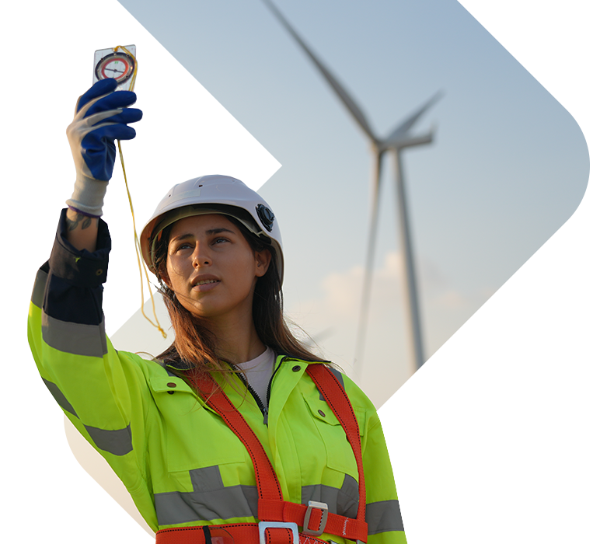
Loiste Lämpö Oy - Sustainable and Responsible Data Center Ecosystem seminar in Kajaani on May 22, 2025

Slide 2
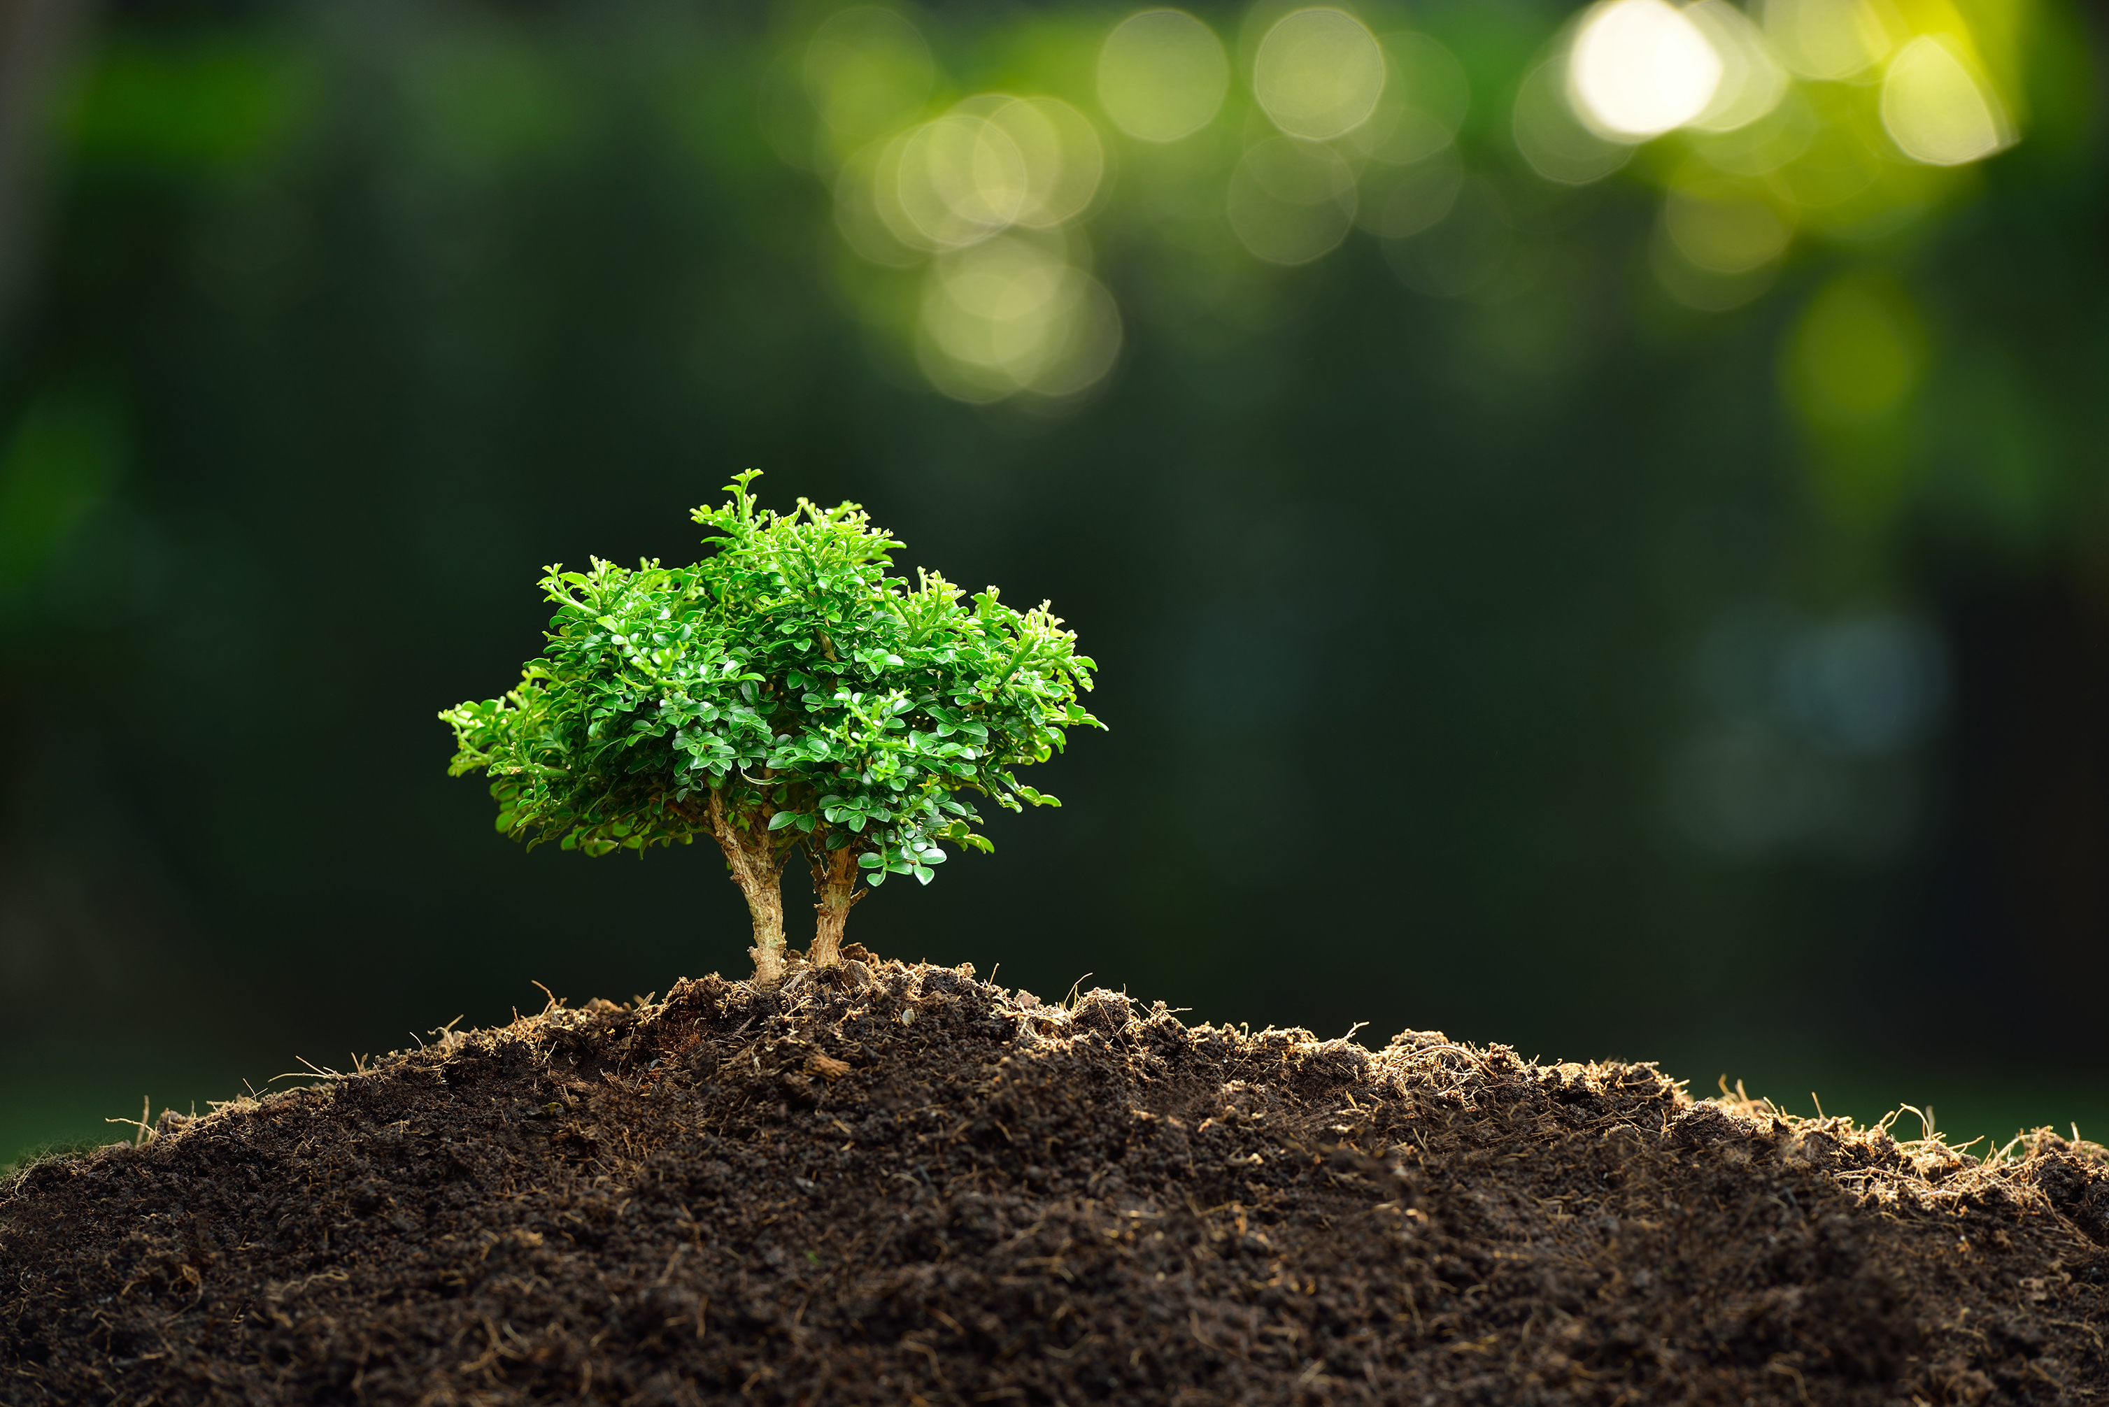
Loiste Oy Environmental responsibility
We work close to people and recognise the impact of our operations on the environment. We take environmental friendliness and energy efficiency into account in all our procurements. We create and offer energy-efficient solutions and services to our customers. We take responsible land use and biodiversity into account both in our own operations and in the operations of our service providers. Our goal is to be carbon neutral by 2026, and we support Finland's transition to carbon neutrality by 2035. We are involved in planning, building and maintaining a weatherproof electricity network that enables the growth of renewable energy production. We are switching to CO2-neutral forms of production in district heating and electricity production. Preventing environmental risks is of paramount importance to us. We also expect concrete actions from our partners to help achieve the CO2 goals in Finland.

Slide 3
Loiste Lämpö Oy – DH production renewal project
Loiste has made the decision to invest in new heat production plants during 2024-2026
The new production will utilise the waste heat in the area and be located into separate locations
Heat pump plants
Electric boilers Pellet boiler
Heat storage (current storage will be modified)
Aiming for cooperation with data centers
Data center produces waste heat for Loiste
Loiste provides cooling for the data center
In the future, there will no longer be a restriction on the reception of waste heat caused by the existing power plant

Slide 4
Palokangas heating plant
20 MW LFO boiler conversion to biofuel
Other LFO boilers will remain in reserve use

Slide 5
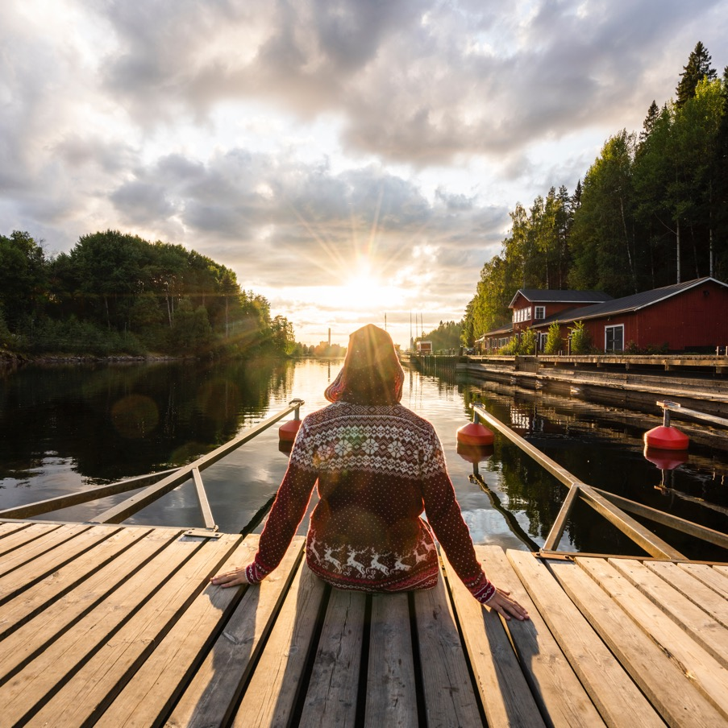
Thank you!

