Slide 1
Teuvo Hatva Chairman of the Board City of Kajaani

Slide 2
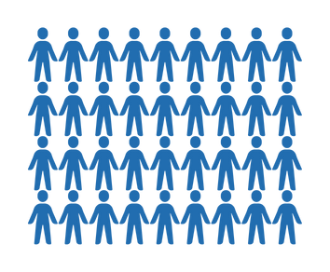
64° 13′ 30″ N, 027° 44′ 00 ″E
Kajaani
Land area
1 836,35 km2
Inland waters
427,76 km2
Total area
2 264,11 km2
Data Center Ecosystem
Supercomputer LUMI
Suomi, Finland
Regional capital of Kainuu
From Helsinki to Kajaani in one hour
City employs approx. 2000 employees
GameCity
Kajaani
Kajaani City Theatre
Population
Total
Forest area
about
7000 ha
All
Four
seasons
Seminaari Art Campus
2000
small and large
events
per year
Living
26/7
Tax rate
8,4 %
36 300
Europe's northernmost stone castle

Slide 3
History
Consolidation of the City of Kajaani and the rural municipality
1977
Paper mill closed 2008 → Renforsin Ranta business park
Airport for scheduled flights
1956
CSC Oy’s
Finland’s national supercomputers 2012
Kajaani University Consortium of the University of Oulu 2004
-1716
1651
1825
1900
1904
1917
1956
1966
1977
1995
2004
2007
2008
2010
2012
2015
2021
Kajaani Castle 1604-1716
Highway
1825
Railway 1904
Talvivaara
becomes Terrafame 2015
Founded in 1651
Paper mill
1917
Consolidation of the municipality of Vuolijoki and the City of Kajaani 2007
Kainuu Brigade
1966
Skoda Transtech, manufacturer of trams 2015
Seminaari college for school teachers 1900
Kajaani University of Applied Sciences 1995
Abolition of the teacher education 2010
LUMI supercomputer 2021

Slide 4
www.kdce.fi

Slide 5
Kajaani Data Center Ecosystem
New brand published 3/2025
Mission. We strengthen data center-driven business and integrate local companies into the value chain.
Vision. Kajaani is home to the world's leading responsibly and sustainably operated data center hub.
Values.
Community. The local community is actively involved in building the ecosystem. The ecosystem fosters collaboration among industry players.
Responsibility. The ecosystem operates in an ecologically, socially, and economically sustainable manner.
Reliability. The ecosystem ensures highquality operations, providing a secure and trustworthy environment for all stakeholders. Its activities are stable and long-term.
Progressiveness. Built on strong expertise, the ecosystem is a pioneer and a driving force in enhancing the region’s vitality and future development.

Slide 6
Kajaani Data Center Ecosystem
Arctic Capital of the Data Center Industry
Kajaani Data Center Ecosystem connects the region’s data centers, businesses, and other stakeholders.
Data centers benefit from services, workforce availability, and an improved operating environment, while local businesses and residents gain from economic growth and increased vitality.
The ecosystem brings the community together, and together we establish an attractive Arctic data center capital.

Slide 7
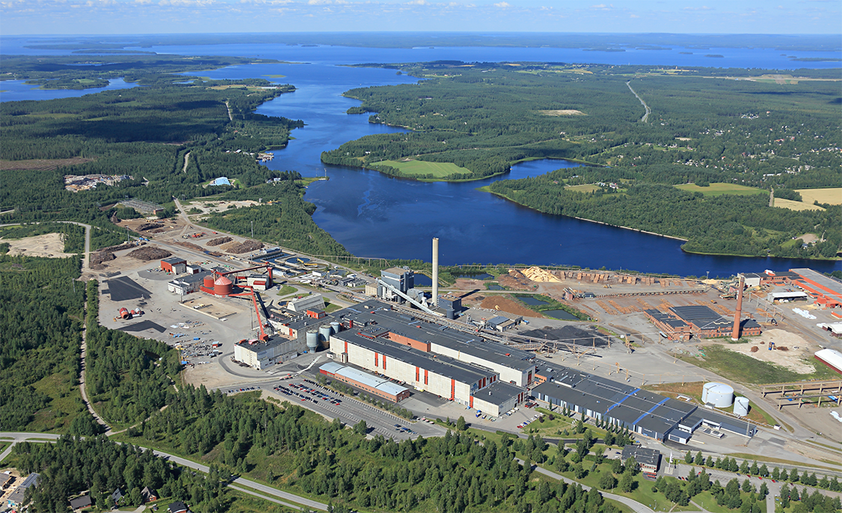
1
Kajaani Data Center Projects
XTX Markets, the first data center to be completed in 2026.
Renforsin Ranta Business Park: - CSC Data Center: LUMI EuroHPC and National supercomputers - Borealis Data Center
2
3
3. Otanmäki area – 35km
General plan initiative for data center operations
Google's land areas.
Renforsin Ranta Business Park, Kajaani

Slide 8
Welcome to Kajaani ☺ Thank you!
www.kdce.fi www.kajaani.fi

