Slide 1
FINLAND
The best European data center location
SAFE, GREEN CONNECTED & COST-EFFICIENT

Slide 2
ABOUT FDCA
FDCA is an independent, nonprofit association dedicated to the data center industry. FDCA provides the ecosystem for cloud & data center businesses in Finland.
Founded in
2014
+140
Company Members plus 200 Person Members outside member companies.

Slide 3
FDCA CORNERSTONES
Industry representative
Education support
ISO Standardization
Networking events
Visibility in media & abroad
FDCA is an industry representative in data center and cloud areas and actively fosters the cluster in Finland
FDCA supports education by facilitating theses, work opportunities and data center & cloud focused trainings
FDCA supports and funds ISO standardization work in IT and in the data center field
FDCA organizes various events in the data center field for its members and other stakeholders
Attractiveness of the data center and cloud field. Attractiveness of Finland and location for data center and cloud services

Slide 4
#1 Datacenter location

Slide 5
DATACENTER INDUSTRY IN FINLAND
Existing capacity:
Public Cloud(example MS, Google) | 150–200 MW | 150–200 MW
Colocation (example Telia, Equinix) | 45–65 MW | 45–65 MW
Company internal | 15–20 MW | 15–20 MW
Public sector | 10–15 MW | 10–15 MW
New datacenter projects:
AI and other announced projects | 1 300 MW |  | 1 300 MW
AI and other projected projects | 700 MW |  | +1 500 MW
Employment impact of the sector:
Direct jobs (now) | ~1 000
Indirect jobs (now) | 2 000–3 000
Builders of new projects (in the coming years, FTEs) | ~50 000
Datacenters MW
Datacenters now in MW

Slide 6
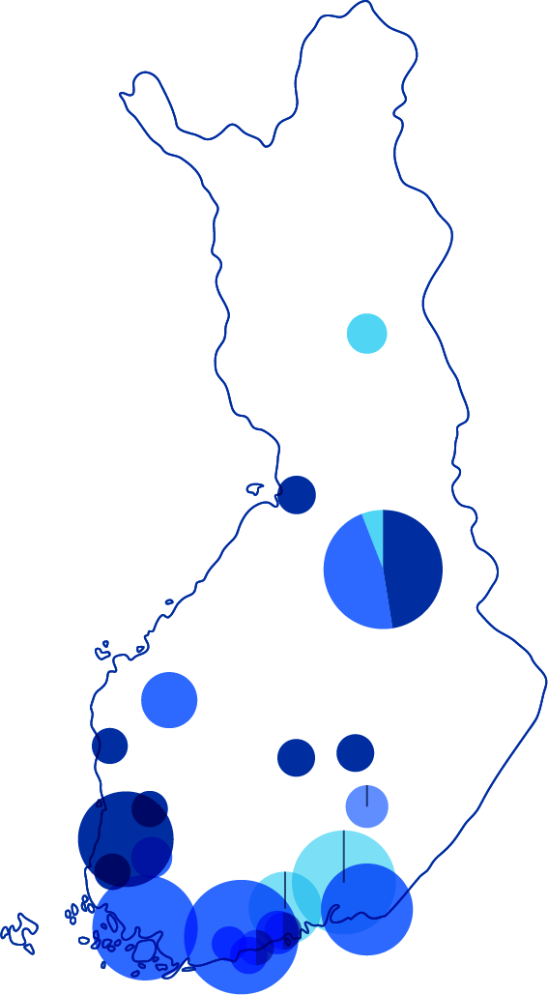
INVESTMENTS BY LOCALITY
Phase
0. Feasibility study
1. Planning
2. Investment decision
3. Start of operation
Green Transition
Estimated data center investments already announced for the clean transition:
12 735 M€
More information in EK’s Green Transition dashboard:
hhttps://ek.fi/en/green-investments-in-finland/

Slide 7
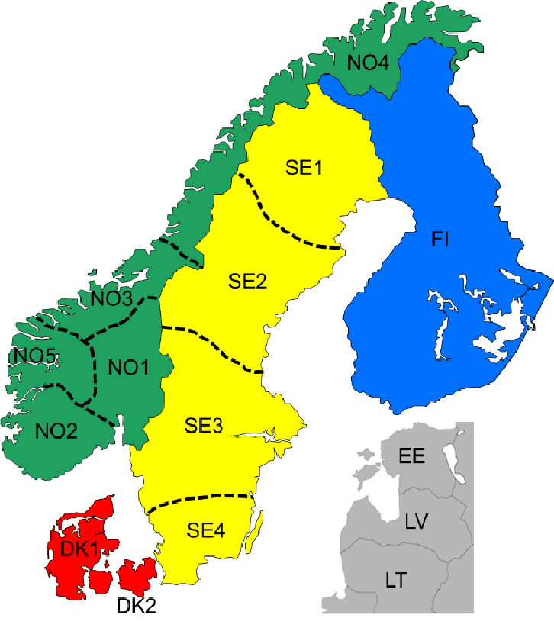
Energy price for datacenters 2024 (€/MWh)
Suomi: Tax class 2
Suomi: Tax class 1
39,25
39,25
52,85
52,85
44,02
44,02
67,97
46,07
52,44
52,44
56,93
56,93
57,92
57,92
66,03
74,07
66,03
74,07
71,14
88,01
71,14
88,01
71,36
71,36

Slide 8
DATACENTER INDUSTRY GROWTH
In February 2024, the FDCA received media inquiries regarding industry growth
We in FDCA board estimated that growth will be 1 GW but might get to 2 GW.
If we were to revisit these numbers now, the outcome would be quite different. If the tax incentive Is maintained, the estimated growth could reach 2–3 GW
All the Nordic countries are see excellent locations for datacenters and Finland is most interested currently
Growth outside Helsinki metropolitan area also happening
Will take 5 to 10 years that all announced numbers can be reach

Slide 10
FINLAND is #1 European datacenter location
EU’S LOWEST
ELECTRICITY COST
THE BEST GRID:
RELIABILITY 99.99995%
THE BEST BUSINESS ENVIRONMENT
for data centers in Europe
#1 DIGITAL ECONOMY
in Europe
95% CO₂ FREE
ENERGY SOURCES
HEAT REUSE CHAMPION
With expirence since 2011

Slide 11
FDCA’S ONGOING ADVOCACY AND POLICY WORK
FDCA continues to share facts and information of the industry
We in FDCA are working in close cooperation with the Confederation of Finnish Industries (EK), Technology Industries of Finland, and other partners to develop a new policy model.
A new public commenting round on the law is expected, potentially taking place in June–July.
The new budget law is scheduled to be submitted to Parliament as early as week 38/39
Notes:
EK = Confederation of Finnish Industiries

Slide 12
FUNDING REQUIRED FOR INFLUENCE
Since FDCA membership fees are based on the organization, our budget did not account for this type of lobbying activity.
To continue and finalize this activity until it is confirmed whether the benefit will remain or be removed, we will require some donations.
Your support is essential, and we sincerely appreciate any contributions you can provide.
If you feel that you could help us, please visit in our exhibition stand.
Notes:
EK = Confederation of Finnish Industiries

Slide 13
Thank you. We’re glad to help You
Veijo Terho
Finnish Data Center Association FDCA Chairman of the Board +358 50 2935 veijo.terho@fdca.fi

