Slide 1
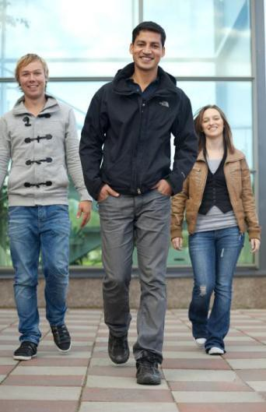
Kajaani University of Applied Sciences Ltd (KAMK)
29.9.2017
1

Slide 2
From Teaching to Coaching – workshop 22.2.2018
International week 2018

Slide 3
In line with the KAMK’24 vision, KAMK
School
KAMK profile
will be Finland’s smartest university.
•
The updated vision and activities based on current phenomena deepen the most proactive university of applied sciences operational model introduced in the KAMK’20 strategy.
Focus area
With the KAMK’24 strategy KAMK
Home Care
Is further profiled in regional development as a true beneficiary of internationalization and digitalization.
Activities are directed by one profile – smart solutions - which cuts through all KAMK activities.
Information Systems
Tourism and Sports
Adventure
Activities
Game and Measurement
Applications
Smart solutions
Each of the 5 KAMK schools has its own focus area which supports the KAMK profile.
Production Systems
Business
Potential
The KAMK profile is built around the focus areas,
i.e. smart solutions are developed by all five schools
All KAMK activities are directed by the following principles:
KAMK is a true beneficiary of internationalization and digitalization.
Our students are at the core of all our activities.
10

Slide 4
Pedagogical Thinking in KAMK
Trends in teaching:
- eLearning
- Learning by Doing in Real Business Cases
- Teamteaching
- Work-Based Learning

Slide 5
Pedagogical Thinking in KAMK
The role of a teacher can be different in different study phases
- traditional lecturer in front of the class
- teacher as a member of the studying team
- teacher is coaching the learning process

Slide 6
Teamteaching
*Enables combining different courses, modules,student groups, study areas eg. Business students language course and sports students customer service and guiding
*Teachers need flexibility, trust
*More extensive and challenging business cases for students

Slide 7
Coaching
Traditional teacher
Coaching teacher
In front of the class
Speaks
Gives answers
Grades individual students
Far from students
Sets objectives and monitors
performance
*Concentrates only in substance and knowledge
Motivates with acknowledgement and punishments
Aside
Listens
Asks relevant questions
Gives continuously feedback, helps students assess themselves
Close to students, available
Helps students to set their own objectives and stay in focus
Concentrates in individuals, teams and relationships
Enhances students to find their motivation

Slide 8
What is essential in coaching?
Be present
Build trust
Strong, relevant questions
Active listening
Ability to be present without involving
Communicating directly
Feedback – encouraging students
Right attitude
Let it go! Students are responsible

Slide 9
Group discussions
From teaching to coaching – what does it mean for a teacher?
How can the coaching teacher help the students to maintain their motivation?
What kind of changes should be made in learning situations?
What should change in facilities, premises etc?
What kind of skills should the graduates have?

