Slide 1
Student Union KAMO

Slide 2
Student Union KAMO
Founded 1998
Based on law since 1st of January 2006
Law says that every UAS has to have a student union
Self-governing
Student Union KAMO does:
The supervision of the interests of the students
Development of the education
KAMO Activities
Tutoring
International tutoring

Slide 3
Student unions organization – Executive board
Authority of administration and execution
President and 5 to 7 members
Supervises members benefits
part of different workgroups
Represents student union
Takes care of funds
membership fees, projects etc.

Slide 4
Executive board 2018
Teemu Turunen
President
Pasi Ahoniemi
Executive Director
Salla Vahvelainen
Student Welfare
Erkki Roivainen
Marketing & Communica-tions
Jani Haaranen
Vice President,
International Affairs
Janina Marjo
Tutor Affairs
Anni Kivikko
Student Educational Affairs
Sakari Vehkaoja
Welfare Tutor Affairs
Vera Bruhn
KAMO Activities

Slide 5
Tutoring
From KAMO to KAMK, part of guiding system
Executive board of Student union KAMO is responsible of tutoring
Tutor training on spring (only in Finnish)
Academic credits

Slide 6
Co-operation agreement – International tutoring
Developing and planning
International team
Welcoming foreign students, orientation days
Events
Plan of operation and annual report every year
Tutoring work group (Chairman of the board is KAMOs head of tutors)

Slide 7
Student Buddy training
For international degree students
Training in spring semester
Academic credits, depending on your activity
Marketing
Assists international tutoring students
In arrival of new international students
Orientation days
Participating in events

Slide 8
Student services
Until opening – KAMO Service point in TAITO 2
KAMO Café in TIETO 1 (opening soon)
Book sale
Study material
Member affairs
Bindings of the thesis
Printing sticker
Overall badges

Slide 9
Student card
The proof of the membership of KAMO is a SAMOK-student card equipped with a sticker of the academic year
All the benefits with one card
Local benefits such as movie theater and restaurants
e.g. Finnish railways and bus companies
Every full-time student of the KAMK can become a member of Student Union KAMO
Ministry of Education and Culture warmly recommends to your own university’s Student Union membership

Slide 10
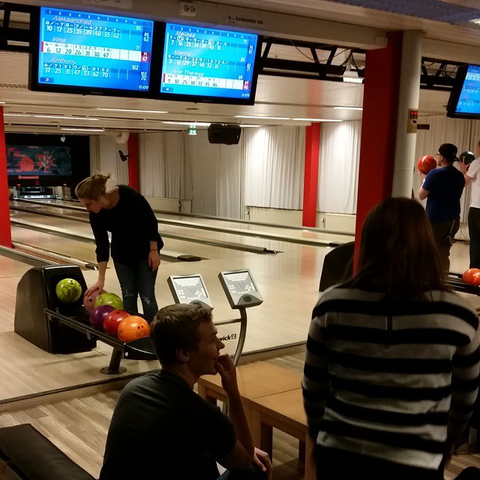
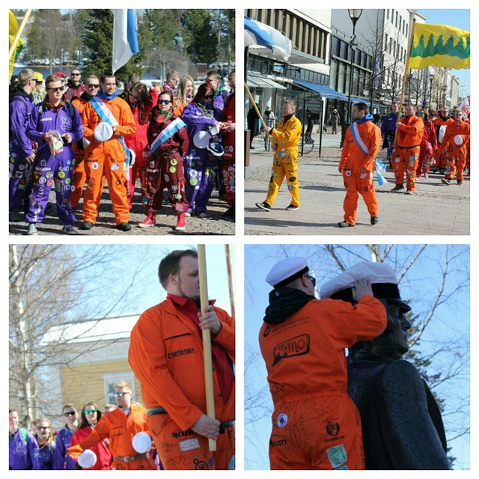
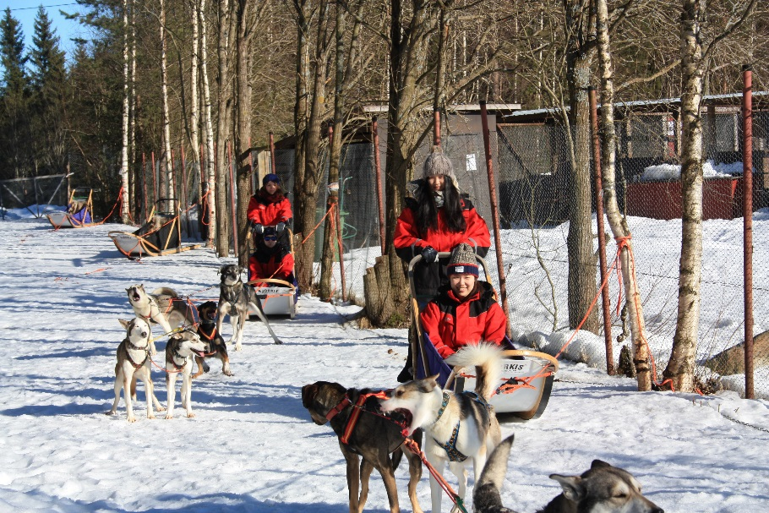
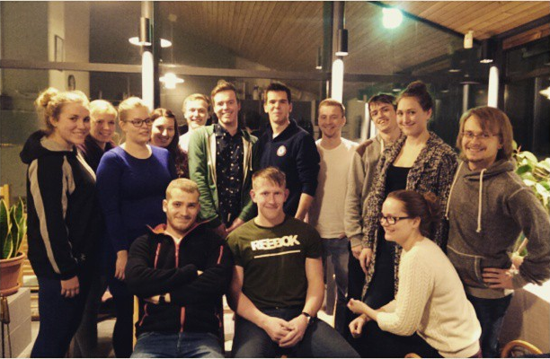
Events

Slide 11
Events
Bowling night
Ice swimming
KAMK Ball Evening
Snow Carnival
Speed Dating
Students’ Wappu
Summer Start
Student Partys at Club 96 once a month

Slide 12
Student 1-on-1 storage system
Locates in F-building, near the laundry
You can collect stuff after your arrival
You can leave stuff behind before you’re leaving.
Storage Days twice every semester.
Basic Idea:
”If you take stuff, you will also bring stuff”

Slide 13
Instructions for Storage
Self-disciplined:
No broken items!
No dirty stuff
Bed linen have to pack in a plastic bag
Scarves, jackets, gloves, rain coats and umbrellas are welcome, NO other clothing items. (Only clean stuff!)
No Food items.

Slide 14
If there wasn’t Student Union KAMO…
Who would make sure that students opinions will come out when they are making decisions ( for ex. curriculum and price of lunch, etc.)
Who would make sure you will get your overalls, arrange parties and other events
Who would take care of our exchange students
Who would take care of our new students
Who would take care of binding your thesis
Who would take care of YOU

Slide 15
Contact information of KAMO
Responsible of international affairs
Jani Haaranen tel. +358 44 325 0049
President of the Excecutive board
Teemu Turunen tel. +358 44 325 0047
Executive director
Pasi Ahoniemi tel. +358 44 325 0036

Slide 16
Contact information of KAMO
Opiskelijakuntakamo.fi
Social media:
Facebook Opiskelijakunta KAMO
Instagram
@opiskelijakuntaKAMO
#opiskelijakuntaKAMO
#kamkelämää
#lifeatkamk
Snapchat
opkukamo
Office in Tieto 1
kamo@kamk.fi

